Slide 1
Android

Slide 2


Introduction
Android's mobile operating system is based on the Linux kernel and is the world's best-selling Smartphone.
There are currently over 200,000 apps available for Android that are made accessible through the Android Market, which is the online app store run by Google.
The apps are primarily written in Java.
The Android operating system, including the Linux kernel, contains approximately 12 million lines of code.
In this there are: 3 million lines of XML, 2.8 million lines of C, 2.1 million lines of Java, and 1.75 million lines of C++.

Slide 3
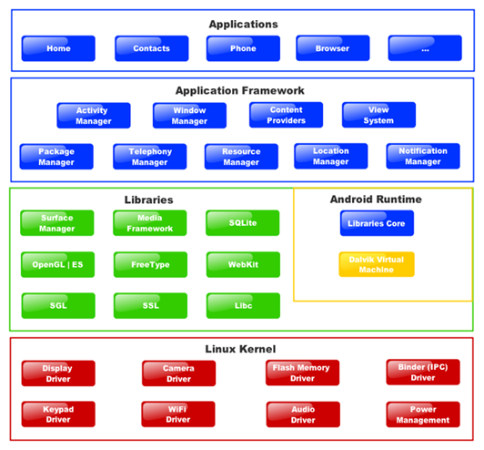

Android Framework

Slide 4
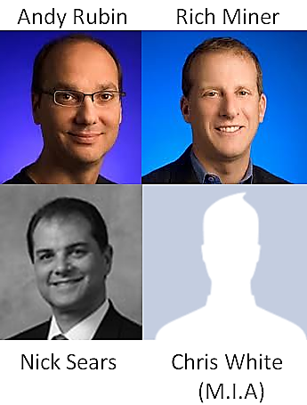
Background
Android Inc. was founded in Palo Alto, California in October, 2003 by Andy Rubin, Rich Miner, Nick Sears, and Chris White.
Their goal was to develop a "smarter mobile device that was more aware of its owner's location and preferences.”
They operated secretively, admitting only that they were working on software for mobile phones.

Slide 5

Background Cont’
Google acquired Android Inc. in August, 2005, making Android Inc. a wholly owned part of Google Inc.
Nick Sears was the only original founder that did not stay with Android Inc. after the acquisition.
At this point in time, many assumed that Google was planning to enter the mobile phone market with this move.

Slide 6
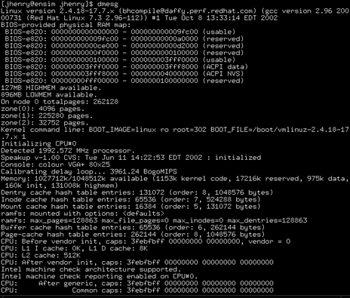
Background Cont’
Once at Google, Rubin led a team to develop a mobile device platform powered by the Linux kernel.
Google marketed the platform to handset makers and carriers with the intent of providing a flexible, upgradable system.
This caused speculation about Google's intention to enter the mobile communications market to build.

Slide 7
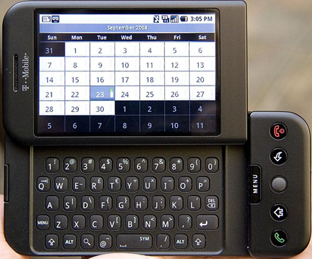
Background Cont’
On October 21st, 2008, Android 1.0 became available to the public.
"Today's announcement is more ambitious than any single 'Google Phone' that the press has been speculating about over the past few weeks. Our vision is that the powerful platform we're unveiling will power thousands of different phone models.“ -Eric Schmidt, former Google Chairman/CEO

Slide 8
Tools
Eclipse
Android studio
Code is written in Java

Slide 9
Hello World Example
Creating a New Project
In Android studio :choose File→New→New Project
Next, You need to fill out your project properties.
“My Application“: is the plain English name of your application.
Type ‘HelloWorld’ as a project name
A project name should be one word. (“CamelCase” naming convention is preferred)
“The package name”: for example ‘android.section’
Next, you need to choose the build target.
The build target tells the build tools which version of the Android platform you are building for.
Specify An activity that is going to be represented by a Java class.
Its name should adhere to Java class naming conventions: start with an upper-case letter and use CamelCase to separate words.
So, type ‘HelloWorld’ for your activity name or leave it as ‘ HelloWorldActivity’.
Finally, click on the Finish button, and Android studio will create your project.

Slide 10
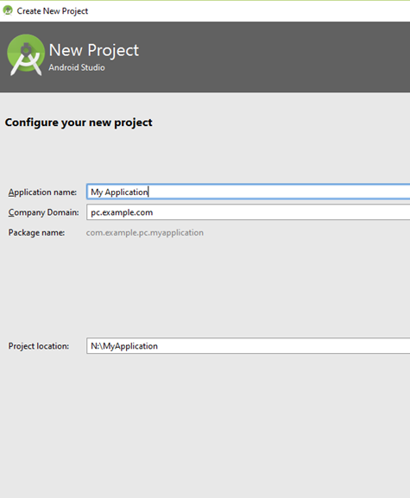
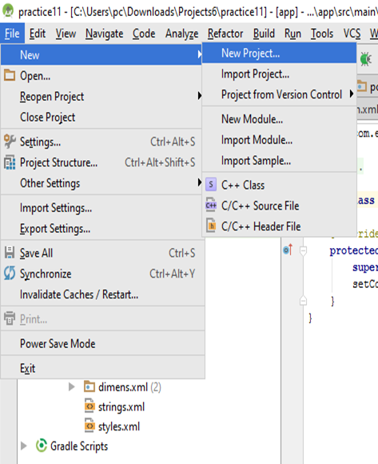
Hello World Example Cont’

Slide 11
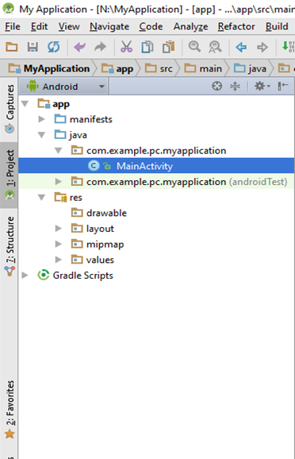
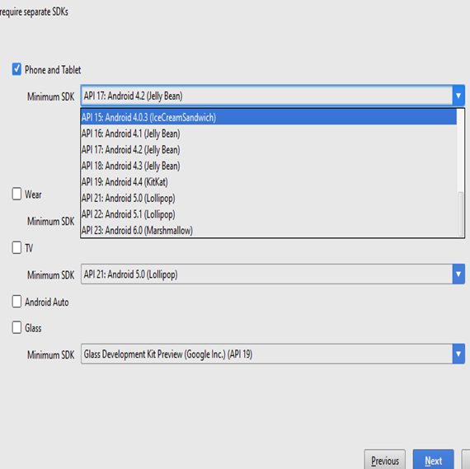
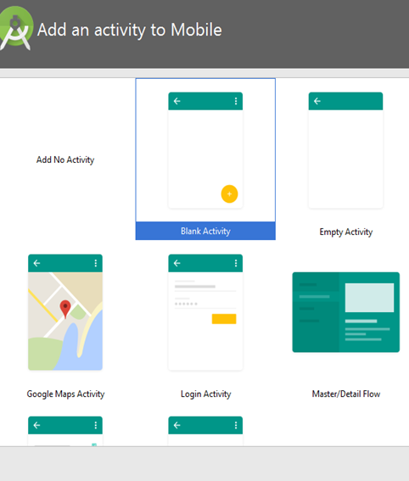
Hello World Example Cont’

Slide 12
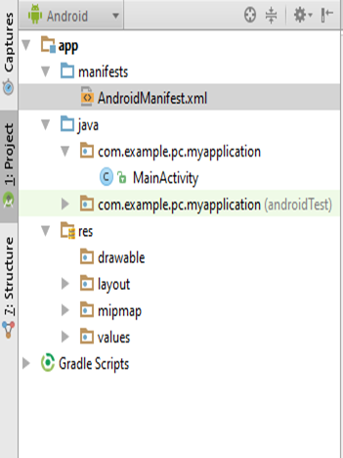
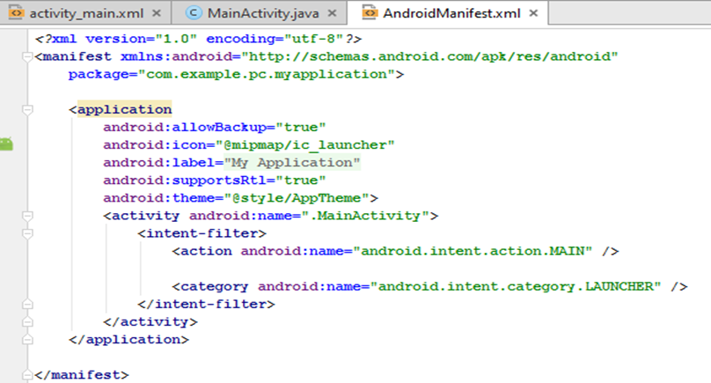
Manifest File
It is this file that explains what the application consists of, what all its main building blocks are, what permissions it requires, and so on

Slide 13
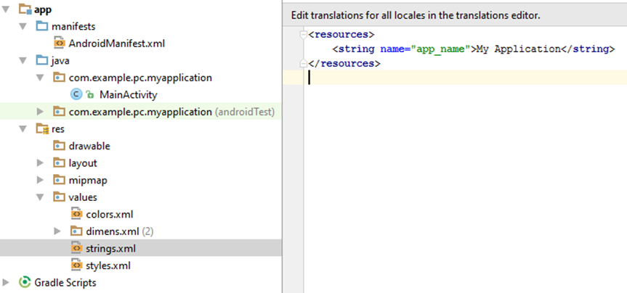
Strings File
This is another XML file that contains all the text that your application uses. For example, the names of buttons, labels, default text, and similar types of strings go into this file.

Slide 14
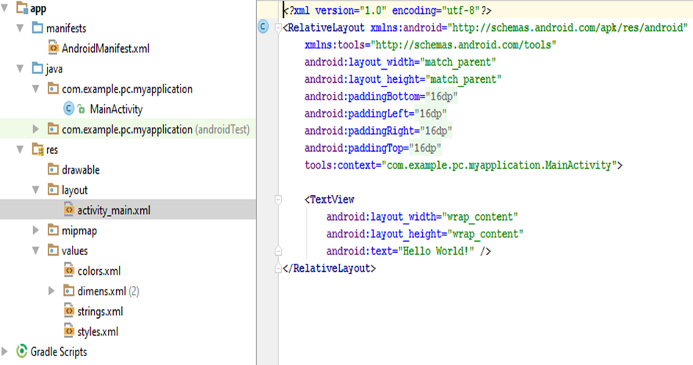
Layout File
The layout file specifies the layout of your screen.

Slide 15
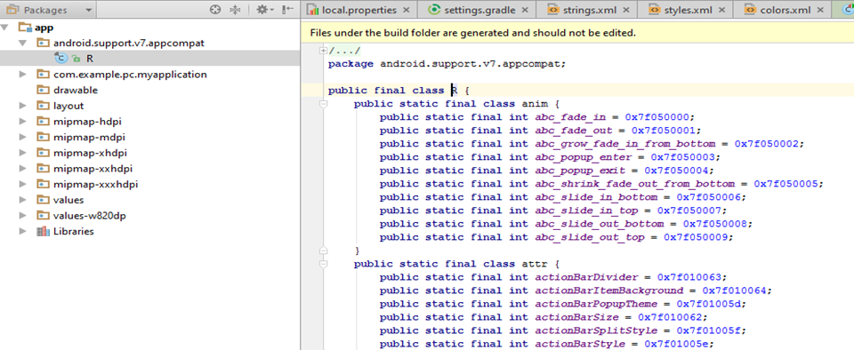
R File
It is an automatically generated file, and as such, you never modify it. It is recreated every time you change anything.

Slide 16
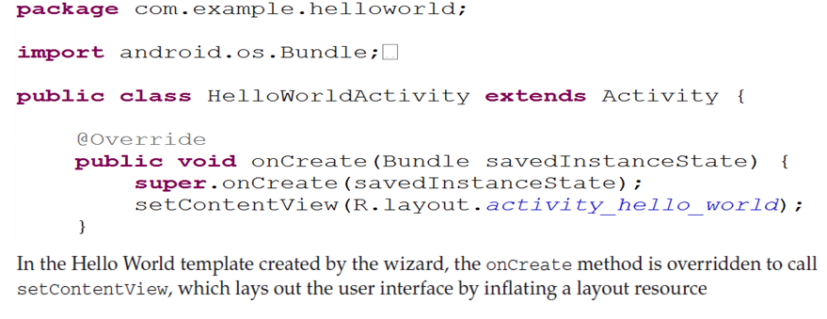
Java Source Code
The Java code is what drives everything. This is the code that ultimately gets converted and runs your application

Slide 17
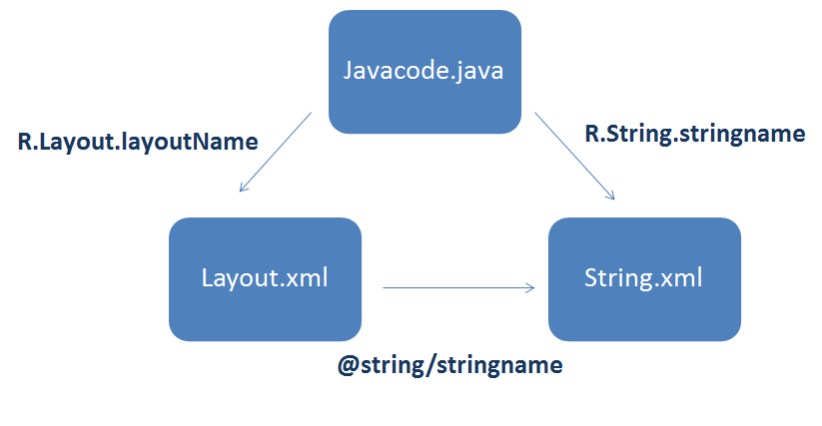
How To access data in files ?

Slide 18
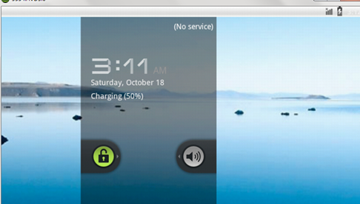
Running Hello World Example
Running the project
First, We will create new Android Virtual Device (AVD)
In Android Studio, Tools Android AVD Manager
Specify Device then target then Name
Finally, Finish
Then right click on the project run MainActivity

Slide 19
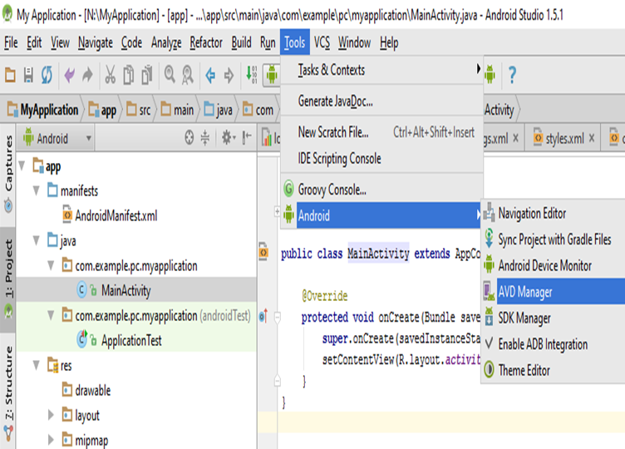
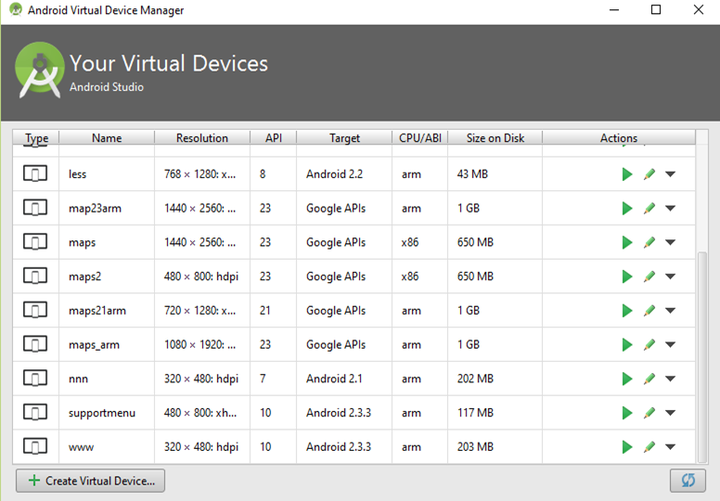
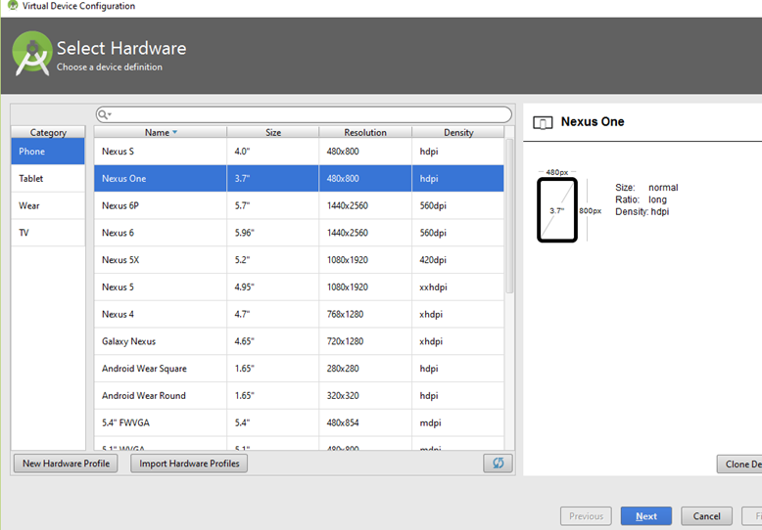
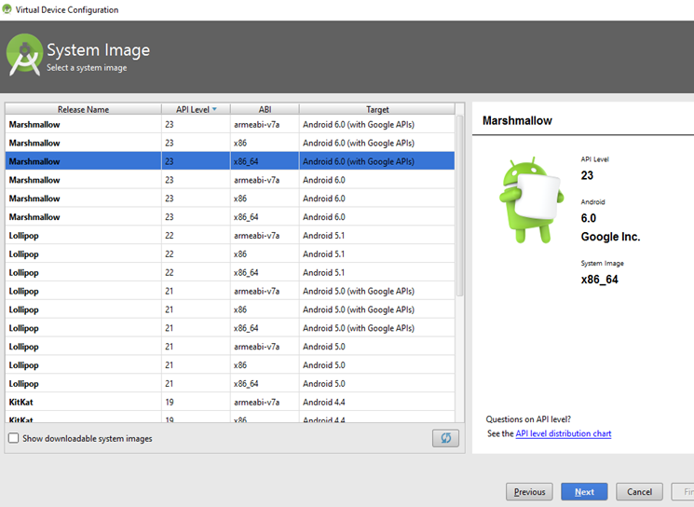
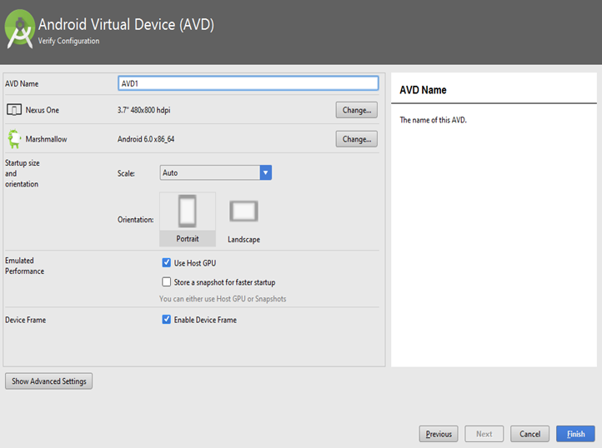
Running Hello World Example Cont’

Slide 20
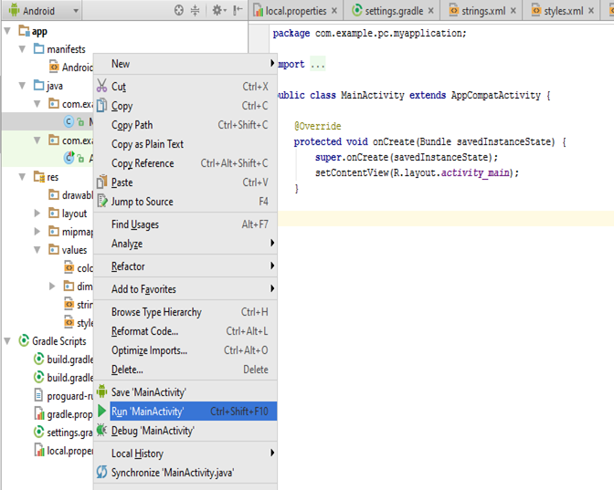
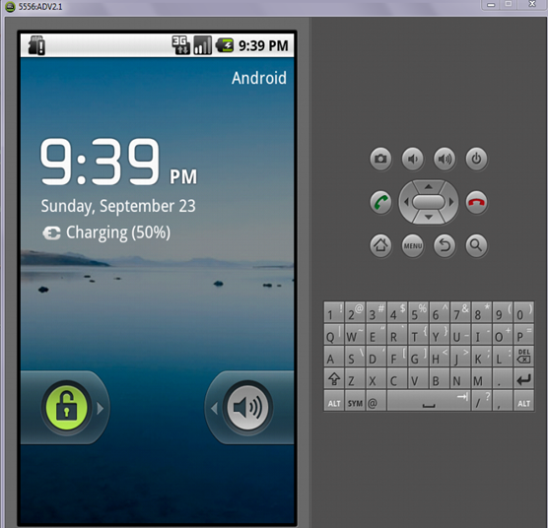
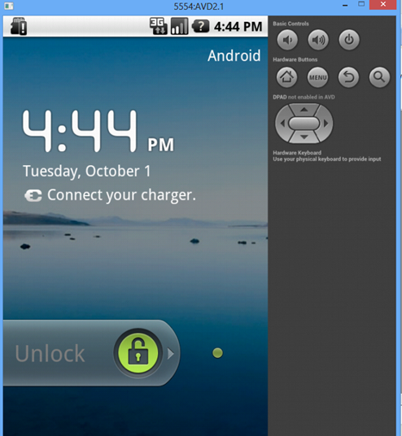
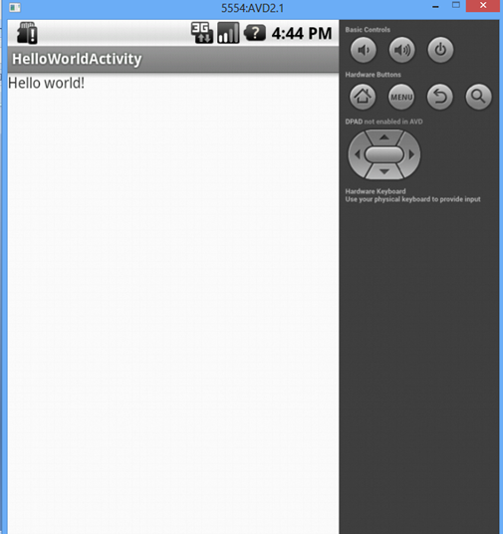
Running Hello World Example Cont’

Slide 21
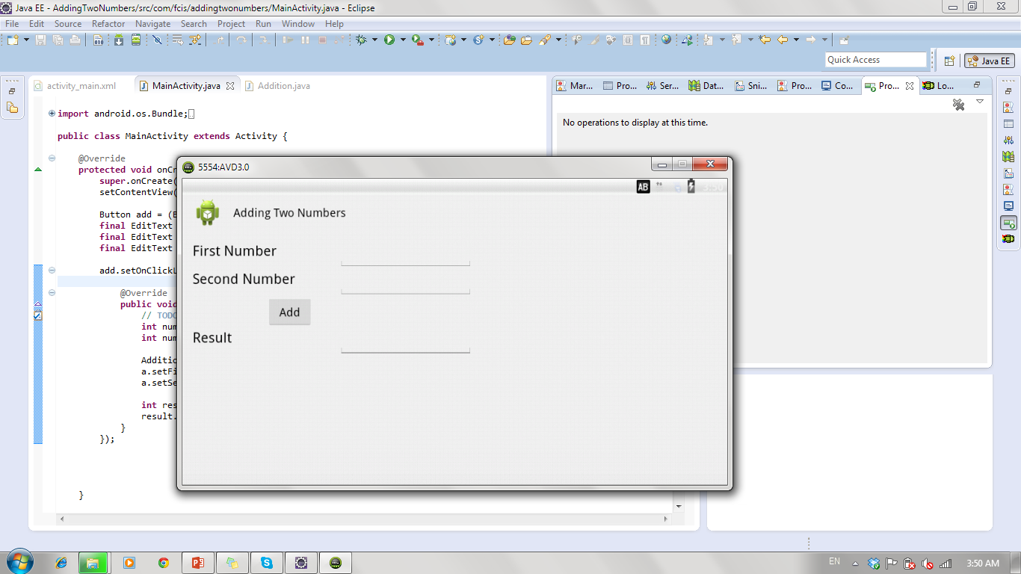
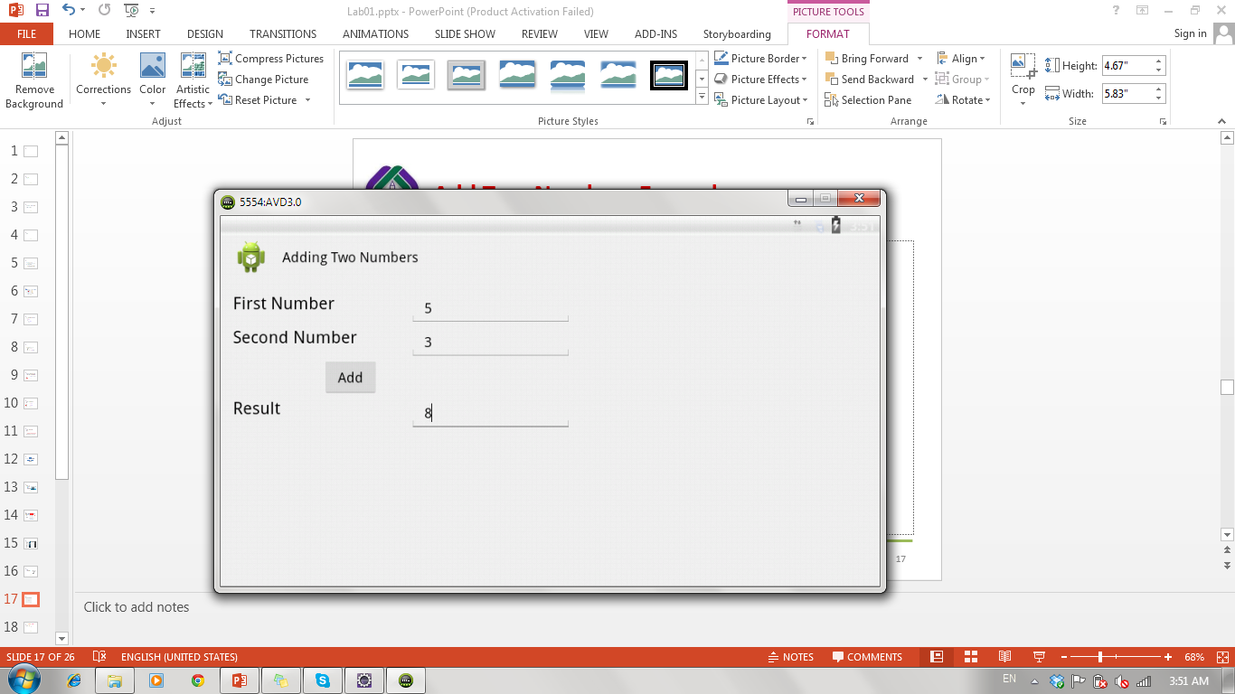
Add Two Numbers Example
Notes:
To change text and id:
Right click on view →Edit id
Right click on view → Edit text → new string → R.String “the name that will be used in code”
→ String that is the value that will be shown
Example: x=“Name” → R.string is x and string is Name

Slide 22
Add Two Numbers Example: What will be changed !!!
Main.xml file → Layout
Main.java file → Code
String.xml file → Texts used in GUI
Note: R file is automatically changed

Slide 23
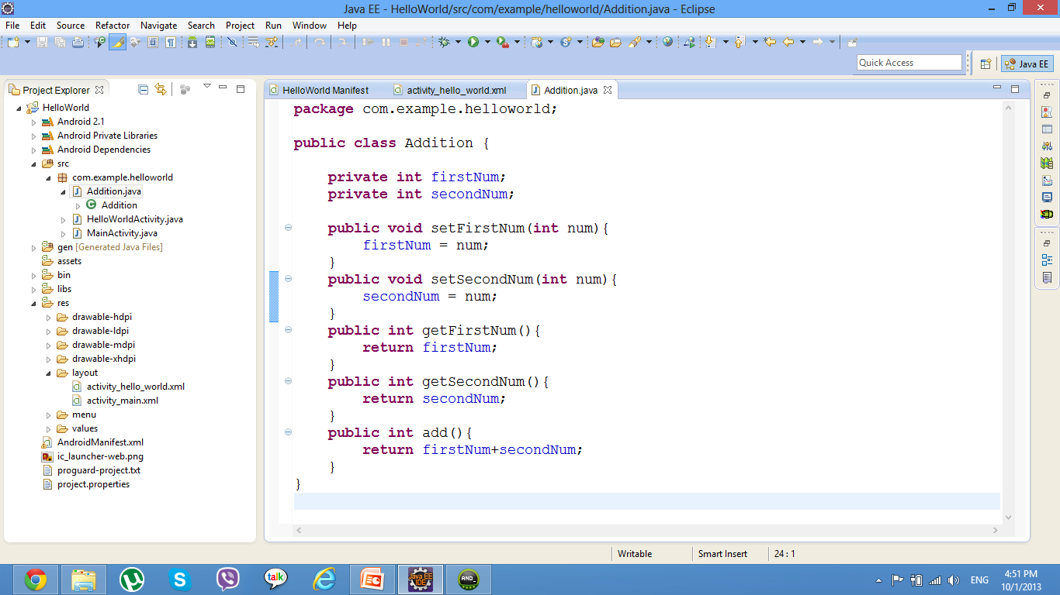
Addition Class

Slide 24
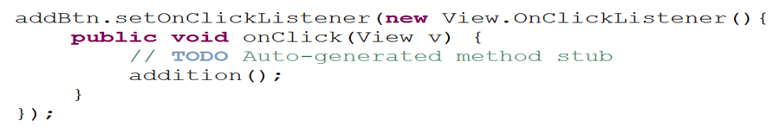
Add Two Numbers Example: How to add action on the button?
First we need to get button id so we can add action listener on it.
findViewById(R.id.btn_add)
Then add actionListener to the button on the main.java in the onCreate Method
Notes:
- You implement an action listener to define what should be done when an user performs certain operation.
onClick(View v) Called when a view has been clicked.

Slide 25
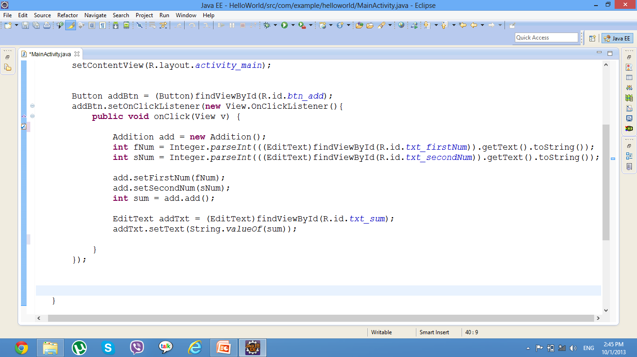
Add Two Numbers Example: implementation
Get FirstNum text through its id from R file
Get number entered by user in edittext

Slide 26
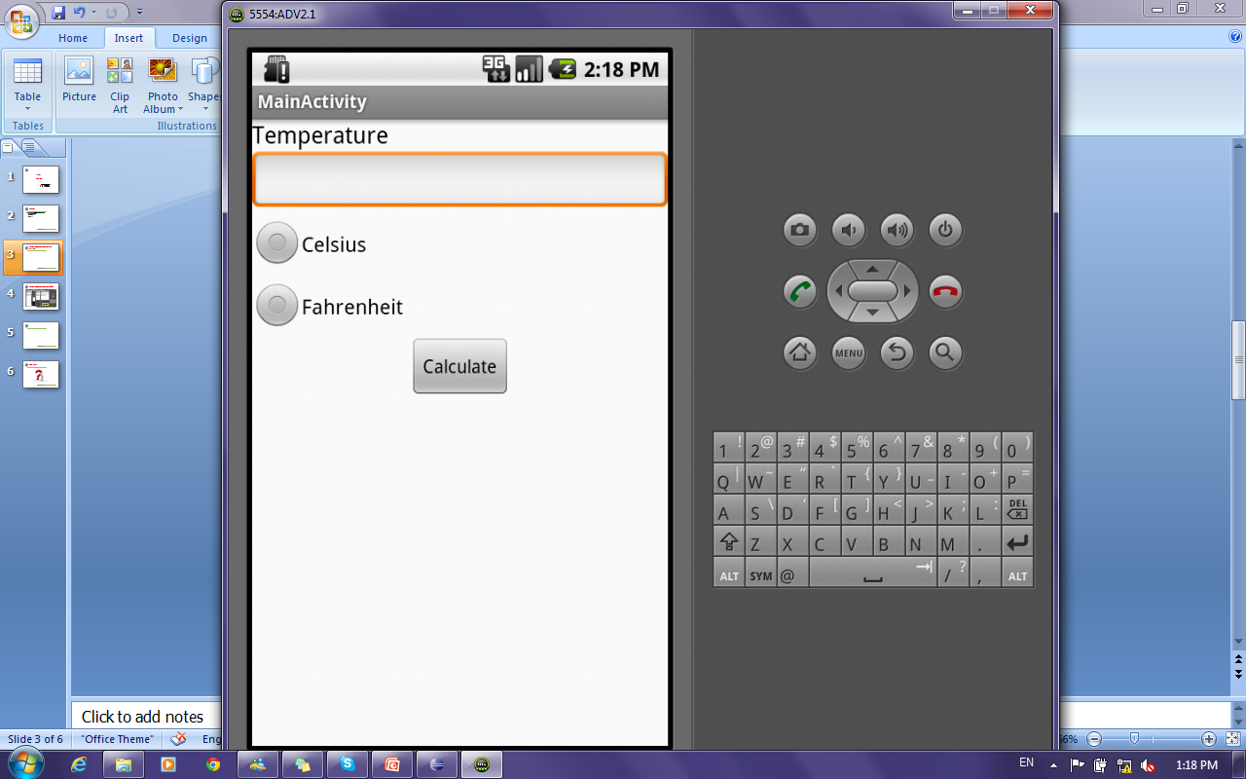
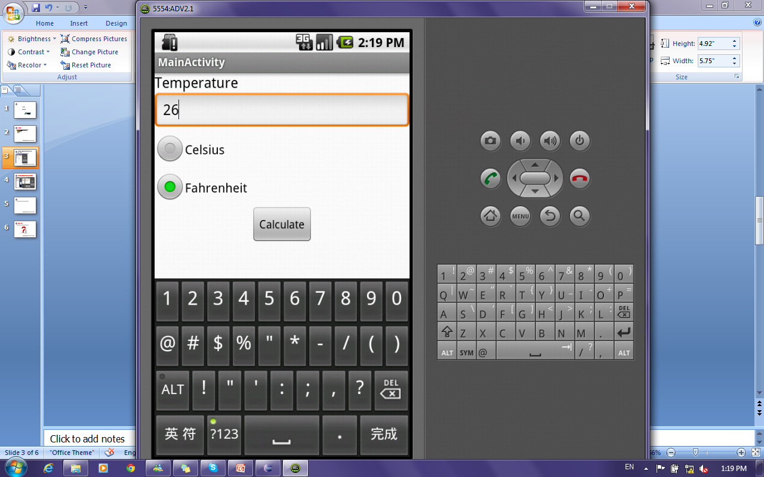

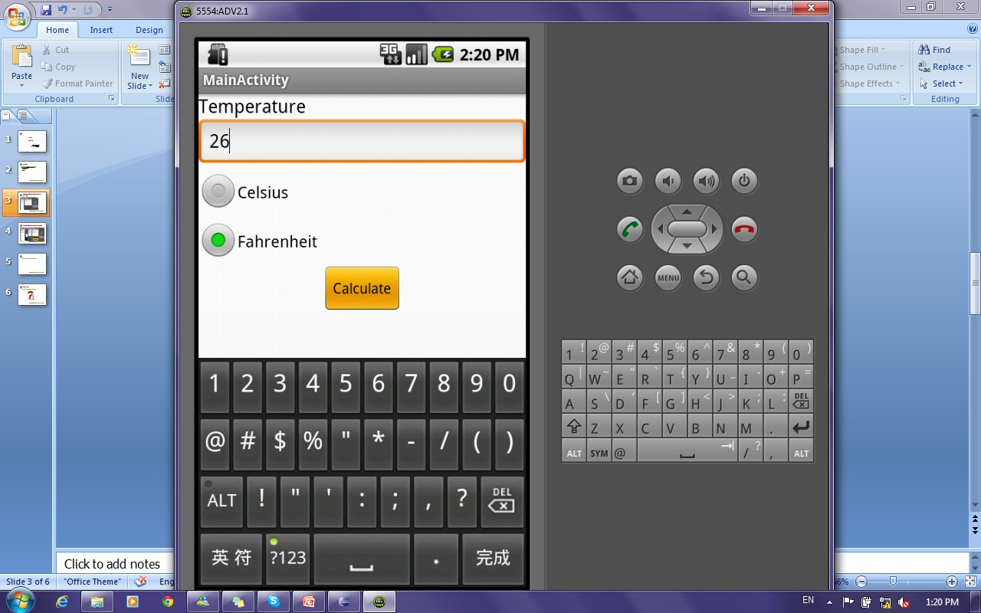
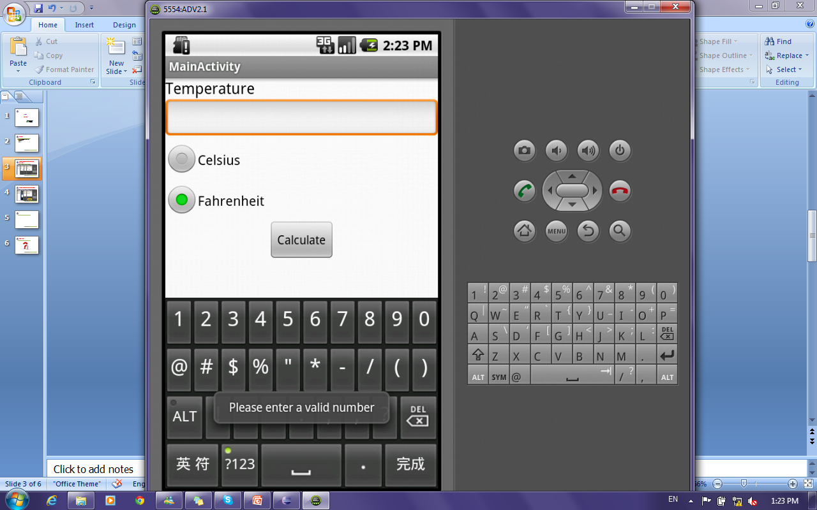
Temperature Converter Application: Radio Buttons

Slide 27
Temperature Converter Application: Toast
A toast is a view containing a quick little message for the user.
The Toast class helps you create and show required message.

Slide 28
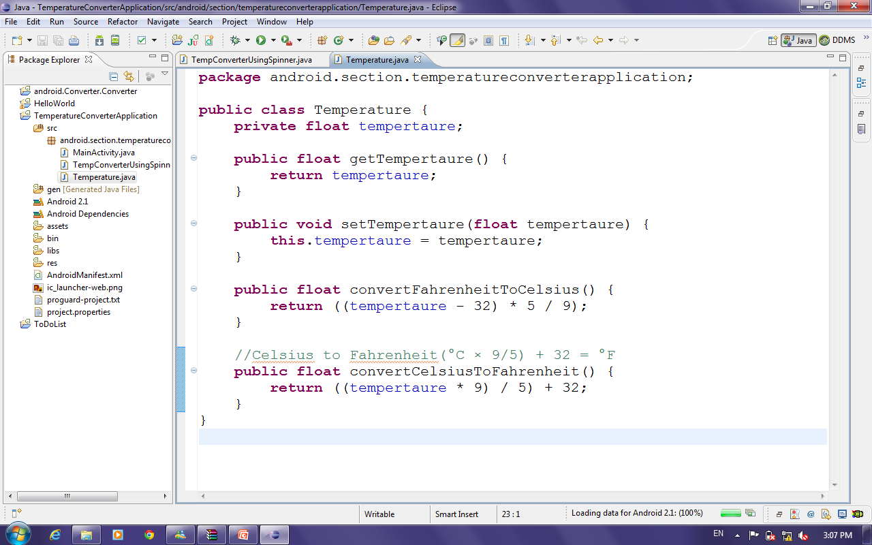
Temperature Converter Application: Radio Buttons Cont’
Temperature Class

Slide 29
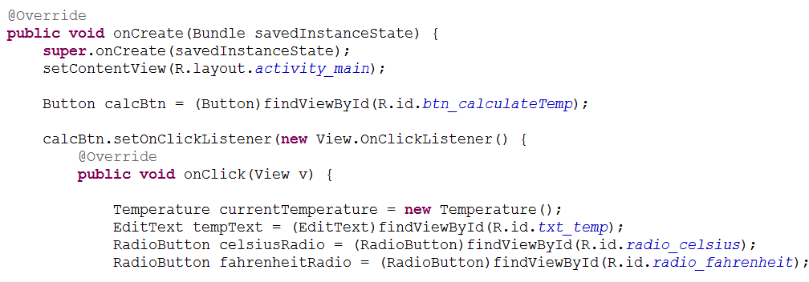
Temperature Converter Application: Radio Buttons Cont’
Get views by their ids.
Add onclick Listener to the button.
Define temperature object.

Slide 30
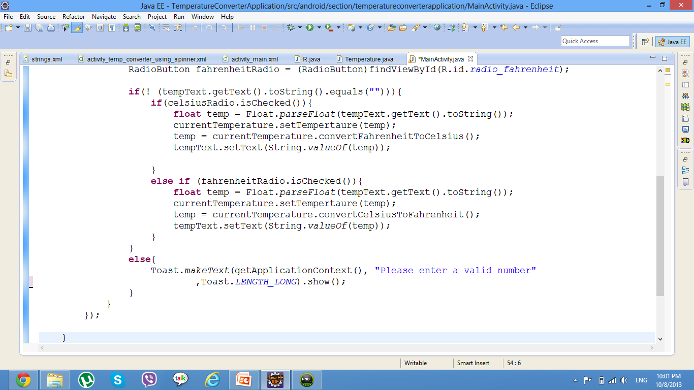
Temperature Converter Application: Radio Buttons Cont’
Converting Tempertaure
Comparing two strings using equals method
Method to check if radio button is checked
Show Msg to user with invalid input
Notes:
LENGTH_LONG Show the view or text notification for a long period of time.
LENGTH_SHORT Show the view or text notification for a short period of time.
makeText(Context context, CharSequence text, int duration) : Make a standard toast that just contains a text view.
Parameters
context: The context to use. Usually your Application or Activity object.
You can get the context by invoking Activity_name.this, getApplicationContext(), getContext(), getBaseContext()or this (when in the activity class).
It lets newly created objects understand what has been going on. Typically you call it to get information regarding another part of your program (activity, package/application). It also gives access to the resources of the project and the global information about the application environment.
For example, you can check the size of the current device display via the Context.
text: The text to show. Can be formatted text.
duration: How long to display the message. Either LENGTH_SHORT or LENGTH_LONG

Slide 31
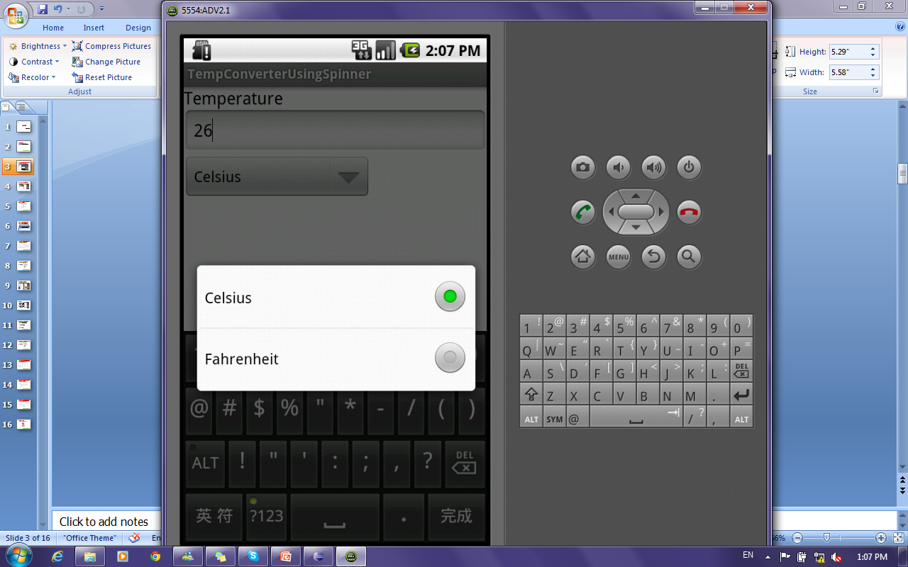
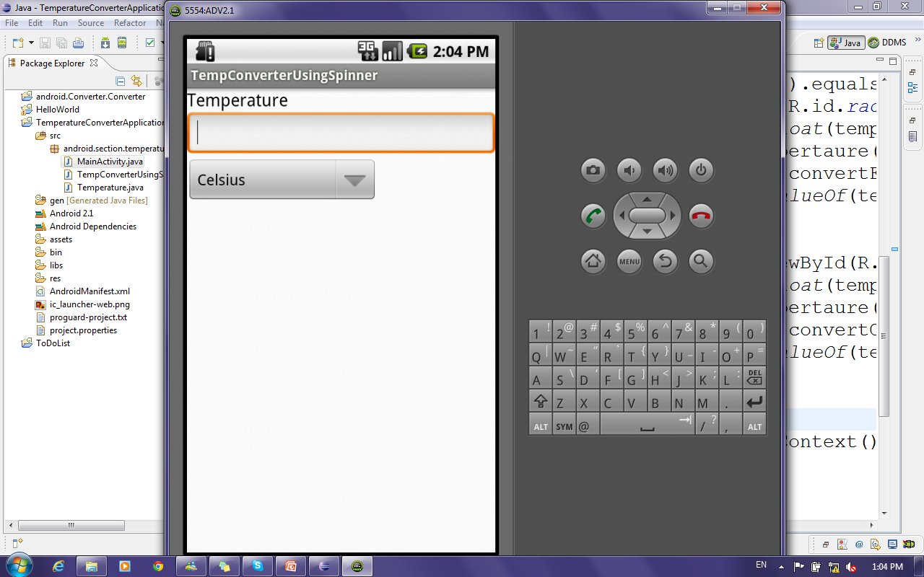
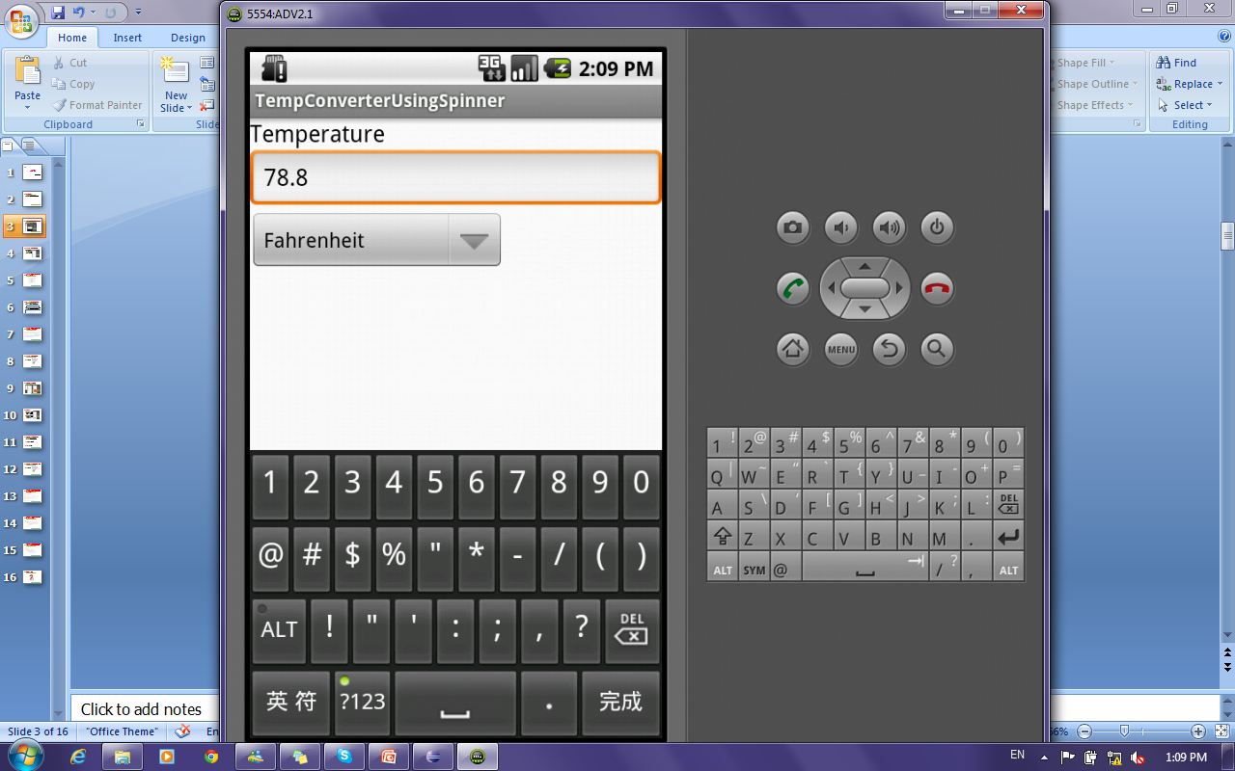
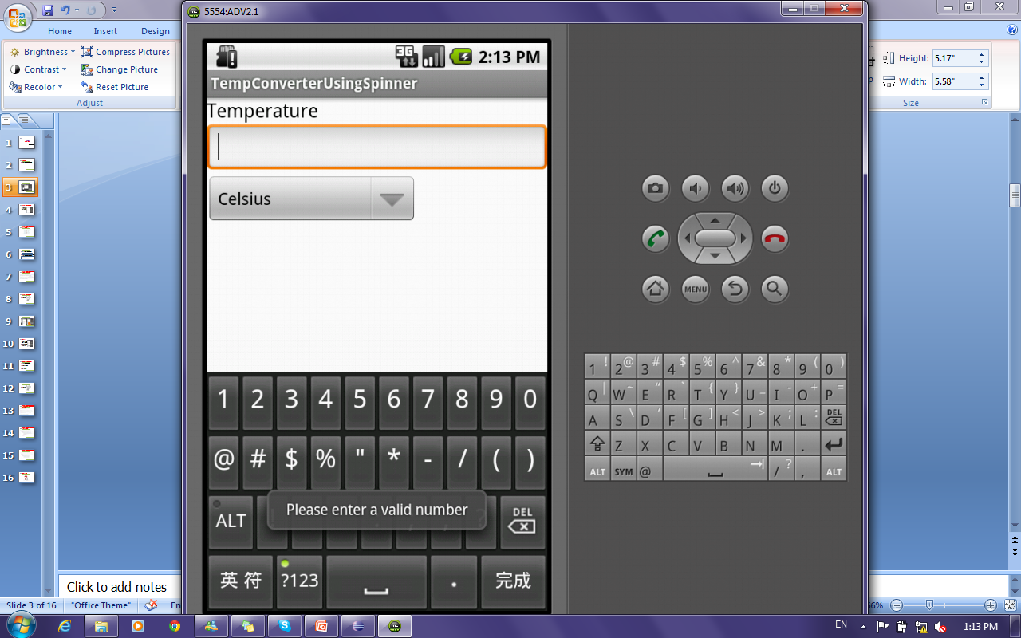
Temperature Converter Application: Spinners

Slide 32
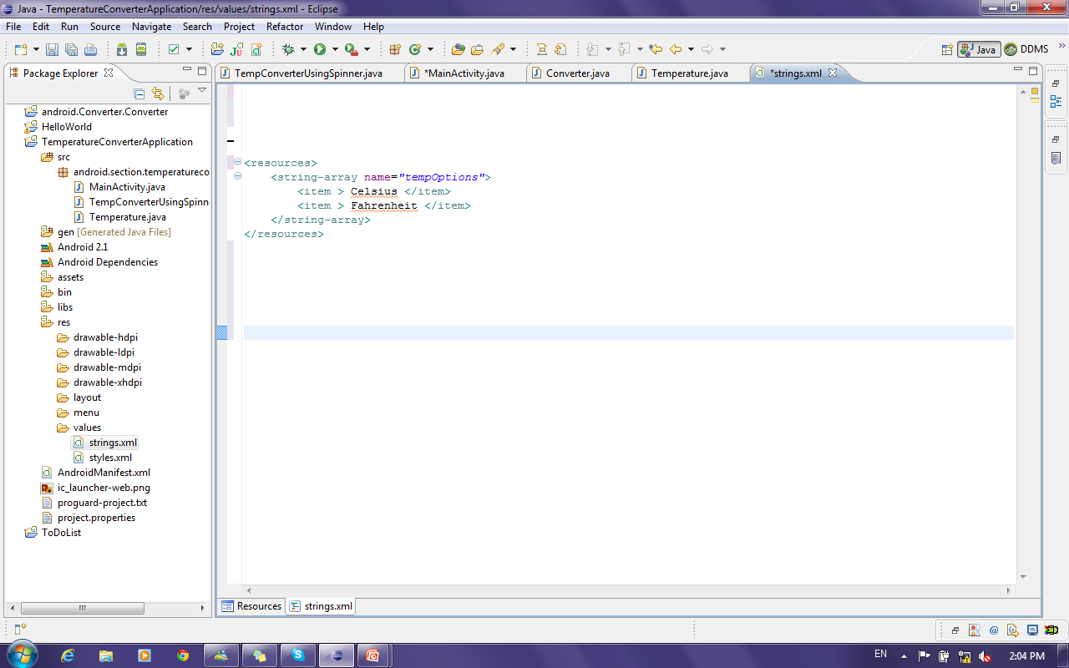
Temperature Converter Application: Spinners Cont’
How to add values in spinners ?!
By Defining an array of strings in the String file

Slide 33
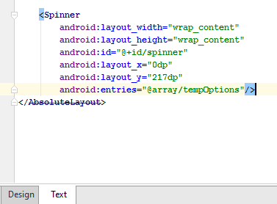
Temperature Converter Application: Spinners Cont’
How to Bind defined array to spinner ?!
Notes:
Two ways to bind array of values to a spinner
In GUI ( right click→show in→ properties→ entries→ array (then select array name to bind to ) )
In Code (Next Lab)

Slide 34
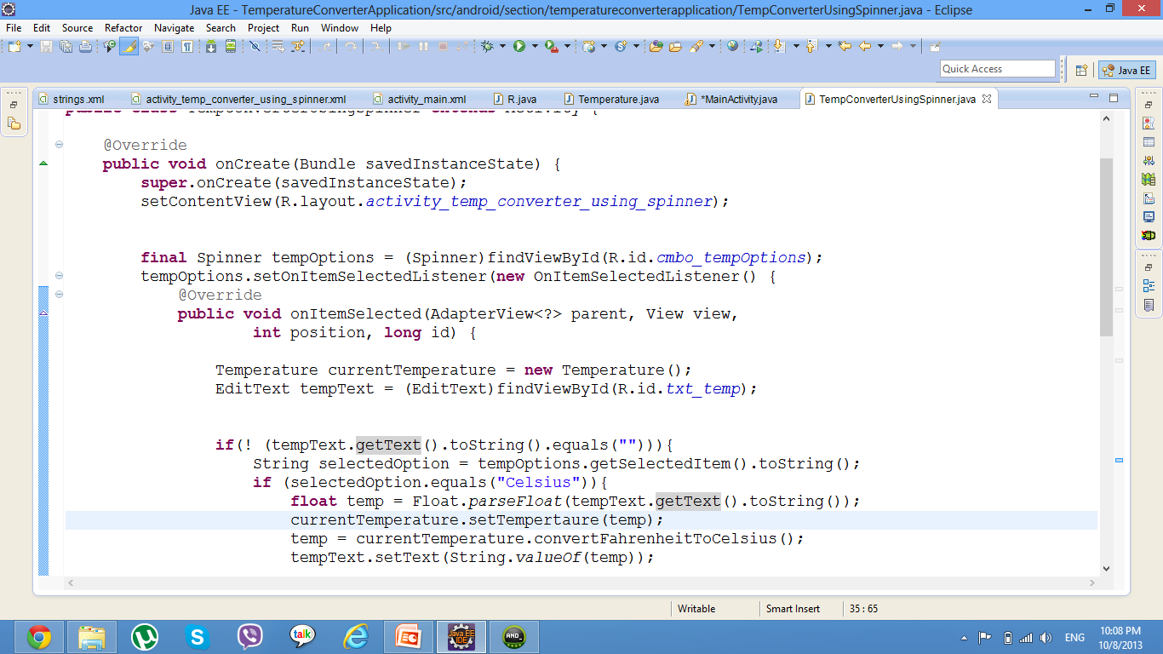
Temperature Converter Application: Spinners Cont’
Notes:
onItemSelected(AdapterView<?> parent, View view, int position, long id): Callback method to be invoked when an item in this view has been selected.
This callback is invoked only when the newly selected position is different from the previously selected position or if there was no selected item.
Impelmenters can call getItemAtPosition(position) if they need to access the data associated with the selected item.
Parameters
parent:The AdapterView where the selection happened
view: The view within the AdapterView that was clicked
position: The position of the view in the adapter
id: The row id of the item that is selected
Why using final keyword:
The variables tempOption is a local variables in the main() method. The object that you create with the anonymous class might last until after the main() method returns.
When the main() method returns, local variables (such as tempOption) will be cleaned up from the stack, so they won't exist anymore after main() returns.
But the anonymous class object references these variables. Things would go horribly wrong if the anonymous class object tries to access the variables after they have been cleaned up.
By making tempOption final, they are not really variables anymore, but constants. The compiler can then just replace the use of tempOption in the anonymous class with the values of the constants (at compile time, ofcourse), and you won't have the problem with accessing non-existent variables anymore.

Slide 35
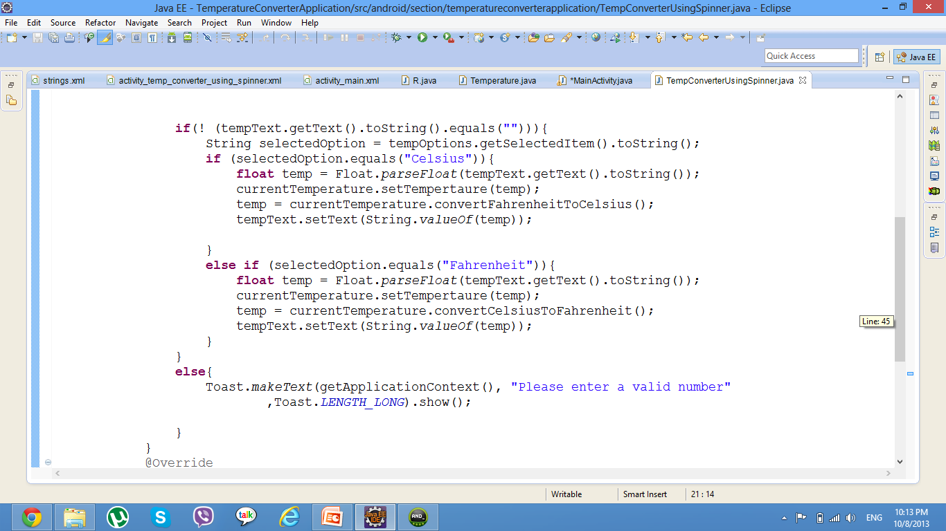
Temperature Converter Application: Spinners Cont’
Method to get selected value from spinner
Converting Temperature
Checking value of returned selected value using equal method
Show Msg to user with invalid input

Slide 36
Deploying Android Application to Mobile
From general settings in your mobile :
- several clicks on build number .
- then developer options will appear.
- enable USB debugging.
- when running the application your mobile will appear online to run on.
OR:
Copy the APK file to your Android’s memory card in your phone.
.apk file exists in :
app folder of your project ->build->outputs
Click and install your APK files.

Slide 37
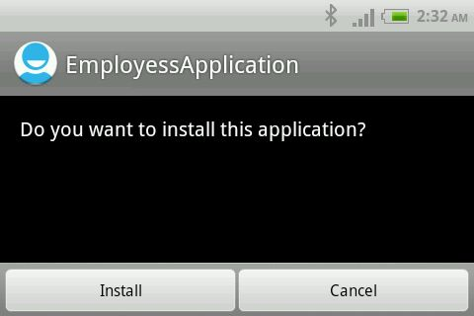
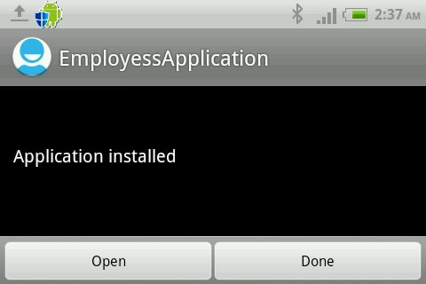
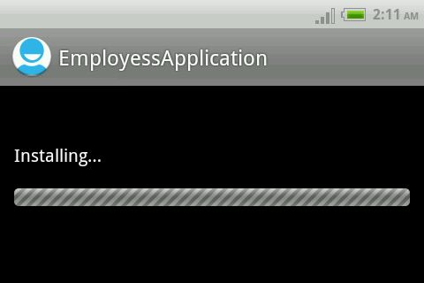
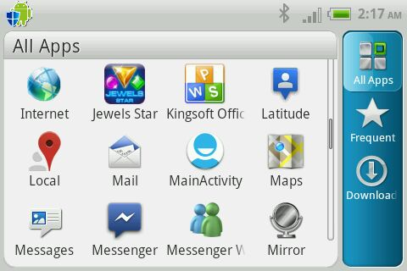

Slide 38
Thanks

